Slide 1

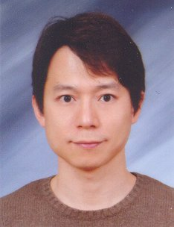


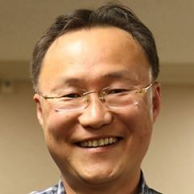


A brief introduction of tenant
Preferred location
Budget
Move-in date
Rental Duration
Priority conditions
Preferred conditions
Furnished
Internet
Parking
Kitchen
TV
Private Bath
Easy VTA access
Additional rental requirements
Contacts
Mutual Friends
Rental type
Rental type
E-mail
Looking for roommate?
Gender Preference
phone

